Slide 1


Fake News Detection using Pre-trained BERT
Raviha Khan (22937)
Gen-AI Semester Project
by RAVIHA KHAN

Slide 2
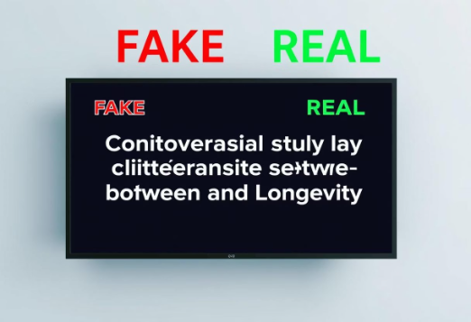
Project Objective
Core Goal
Method
Detect real or fake news
Pre-trained transformer model
Automated classification
Hugging Face integration
Title-based classification

Slide 3

Tools and Libraries Utilized
Key Model
Libraries
DistilBERT-base-uncased-finetuned-sst-2-english
Transformers
Pandas
Scikit-learn
PyTorch
Platform & Data
Google Colab for execution
Fake.csv & True.csv from Kaggle

Slide 4




Dataset Overview and Preparation
Data Combination
Merged Fake.csv (label 0) & True.csv (label 1)
Focus Area
Utilized news titles only
Preprocessing Steps
Labeled, shuffled, and cleaned data

Slide 5
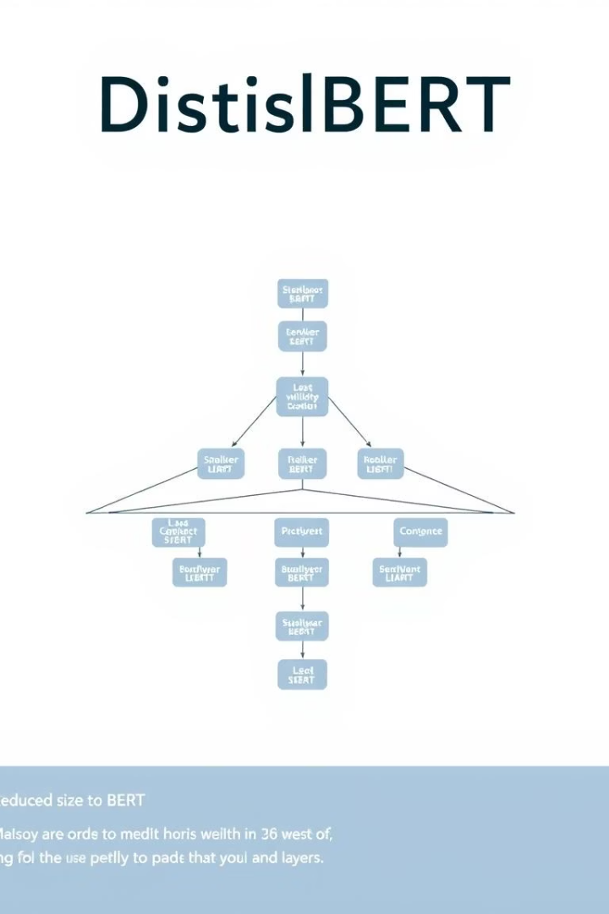



Model Details: DistilBERT
Compact Architecture
Smaller, faster BERT version
Hugging Face Pipeline
Loaded for text classification
Pre-trained Task
Originally on sentiment classification

Slide 6




Classification Logic Explained
Positive Prediction
Mapped to Real (1) News
Negative Prediction
Mapped to Fake (0) News
Application
Applied to news titles

Slide 7
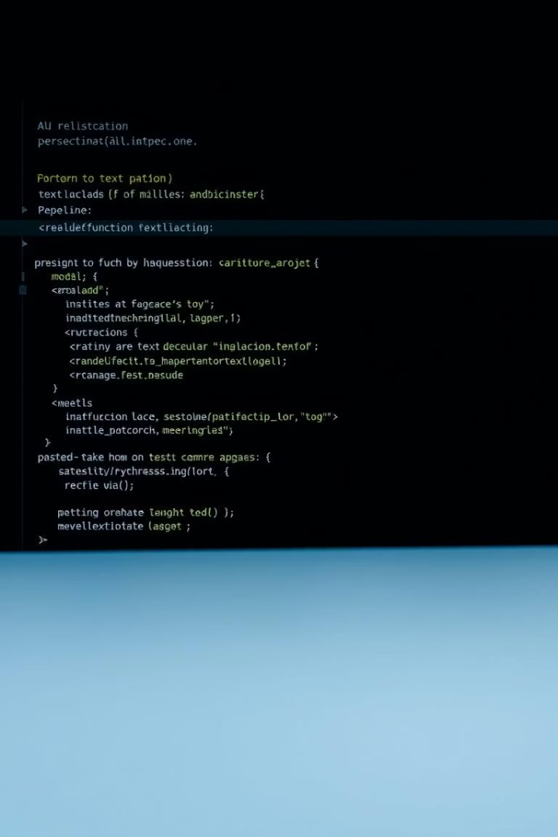
Implementation Snippet
classifier = pipeline("text-classification", model="distilbert-base-uncased-finetuned-sst-2-english")results = classifier(list_of_titles)

Slide 8
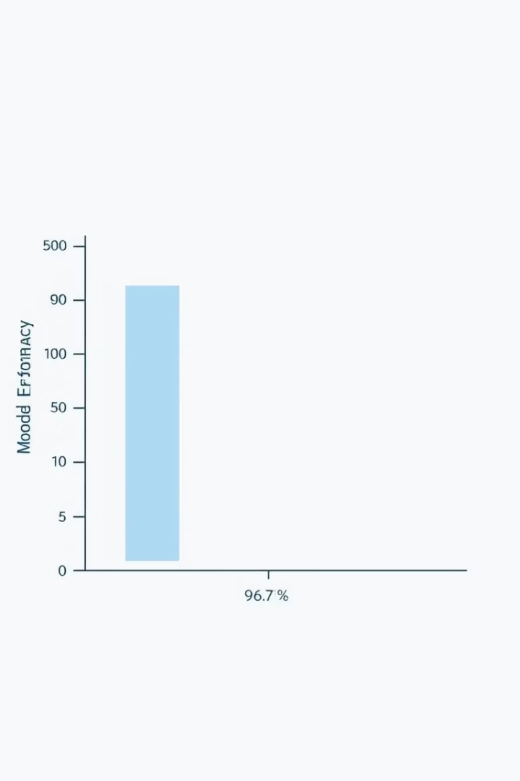
Accuracy Evaluation Results
96.5%
1
0
Accuracy Achieved
Prediction Conversion
Ground Truth Comparison
High accuracy on test sample
Binary format conversion
Utilized accuracy_score metric

Slide 9



Conclusion and Key Takeaways
Transfer Learning Power
1
Effectiveness demonstrated
DistilBERT Efficacy
2
Performed well without fine-tuning
High Accuracy
3
Simple title-based classification

Slide 10




Future Scope and Enhancements
Full Article Text
Utilize complete content for better accuracy
Model Fine-tuning
Fine-tune BERT on fake news datasets
Comparative Analysis
Compare with RoBERTa, BERT-large, etc.

